Slide 1

Emotion Detection using Audio and Text Modalities
By :-
Aditya Gupta
Roll No. 210123080

Slide 2
Our Objective
Our objective is to predict emotions expressed in a spoken utterance
All such utterances are classified into the following 7 emotions: Anger, Disgust, Fear, Joy, Sadness, Surprise, Neutral
We take as input the audio of the utterance and the transcript corresponding to it
We start off with simple unimodal methods and then move onto more sophisticated techniques like fusing the modalities
We use the MELD dataset for our use case

Slide 3
Motivation and applications
Emotions are central to human communication — they influence both what we say and how we say it
Machines that can recognize emotions can interact more naturally and intelligently
AI Assistants like Alexa or Siri can personalize responses by adapting to the user's emotional state — for example, responding more gently when frustration is detected
Mental Health Monitoring systems can use patterns in speech and text to detect early signs of stress, sadness, or anxiety, which could support diagnosis and intervention

Slide 4
Why Multimodal?
Neither Text or Audio Modality is sufficient on its own
Problem while using text alone: Does not capture tone, or intensity of emotions
“I’m sorry, but you’re being extremely unhelpful.” Polite phrasing — but emotionally, it’s criticism or frustration. Tone and pacing matter, but are missing from text.
Problem while using audio alone: Captures tone, but lacks context or meaning
“I am fine” Could sound sad, angry, or genuinely okay — depends on intonation and context

Slide 5
About The Dataset
MELD

Slide 6
MELD (Multimodal EmotionLines Dataset)
Derived from the Friends TV show
Contains 1400+ dialogues and 13,000+ utterances
Each utterance includes: Transcript and Audio (.mp4 format)
Each utterance is annotated with one of the seven labels: Anger, Disgust, Fear, Joy, Neutral, Sadness and Surprise
But There are problems with the data that call for some pre-processing !!!

Slide 7
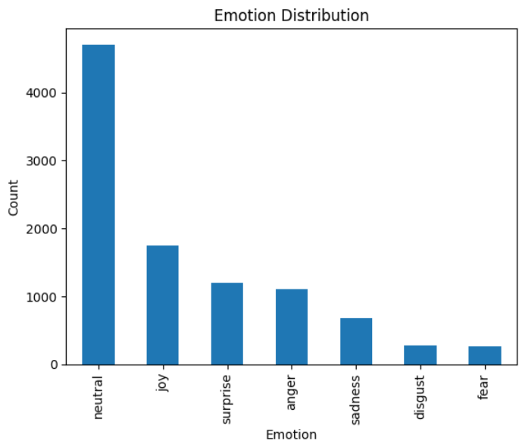
NEED For PRE Processing
Imbalanced Emotion Labels: dataset dominated by “neutral” utterances, Emotions like "Fear" and "Disgust" appear much less frequently, this leads to overprediction of “neutral” and underprediction of “Fear” and “disgust”
Class Confusion Between Similar Emotions: Some emotions have overlapping acoustic or textual patterns

Slide 8
OUR Sampling Strategy
Created a subset of ~1000 samples
Preserved the natural proportions among minority emotions
Down sampled "Neutral" to reduce its dominance, but not eliminate it
We wanted to reflect real-world emotion distribution, where neutral is common
At the same time, we ensured that low-frequency emotions were learnable
Too little neutral → poor generalization
Too much neutral → model ignores other classes

Slide 9
AUDIO UNIMODAL APPROACH

Slide 10
USING Only audio to predict emotions
Goal: Predict emotions using only the audio signal
Motivation: Speech alone can carry strong emotional cues — tone, pitch, rhythm, energy
Extract key audio features from each utterance,
Build a compact 16-dimensional feature vector per sample: MFCC (13 dimensions), ZCR, Spectral Centroid, RMS Energy (1 dimension each)
Apply traditional classifiers (Logistic Regression, KNN, Random Forest)
We use PCA and Confusion Matrix for visualization

Slide 11
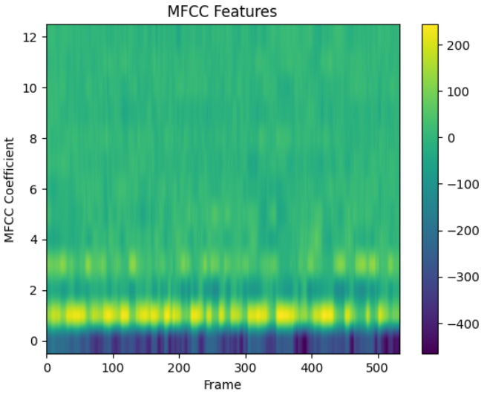
MFCC (Mel-Frequency Cepstral Coefficients)
MFCCs represent how the human ear perceives sound
Capture timbre and phonetic structure
We extracted 13 MFCCs per frame and averaged across time
Emotional states like anger, joy, or fear change the way we speak: shift in the shape and tension of vocal tracts.
MFCCs are sensitive to these variations — they represent how the vocal system was shaped during speaking

Slide 12
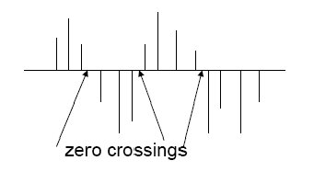
ZCR (ZERO crossing rate)
ZCR counts how often the signal crosses zero
Reflects how frequently the pitch changes
High ZCR: energetic speech (e.g., anger, surprise)
Low ZCR: calm or flat tone (e.g., sadness, neutral)

Slide 13
SPECTRAL Centroid and RMS energy
Spectral Centroid
Indicates the “center of mass” of the frequency spectrum
Higher centroid → more energy in higher frequencies
Often correlates with perceived sharpness or intensity
Angry or surprised speech has a sharper spectral peak; sadness or neutral is smoother
RMS Energy
RMS (Root Mean Square) measures average energy in the signal
Higher RMS: louder, more forceful speech
Lower RMS: quiet, subdued tones
Loudness is a strong emotional cue — joy and anger are typically louder than fear or sadness

Slide 14
Classifiers used
Logistic Regression, KNN and Random forest

Slide 15
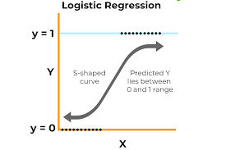
Logistic Regression
“It fits a linear decision boundary by estimating the probability of each class using a logistic function. It’s fast, requires little tuning, and works well when the classes are linearly separable in the feature space.”

Slide 16
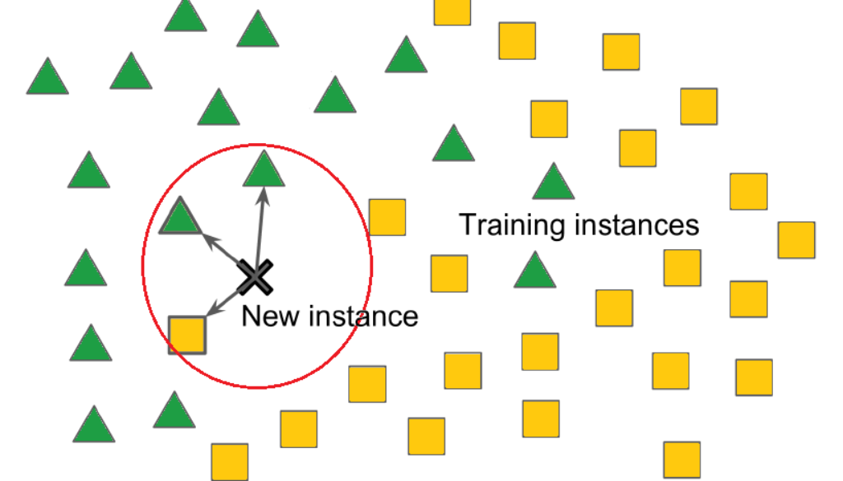
K-Nearest Neighbours (KNN)
“K-Nearest Neighbors is a learning algorithm that classifies a data point by looking at the majority class among its closest neighbors. It makes no assumptions about the shape of the decision boundary, which allows it to capture non-linear relationships.”

Slide 17
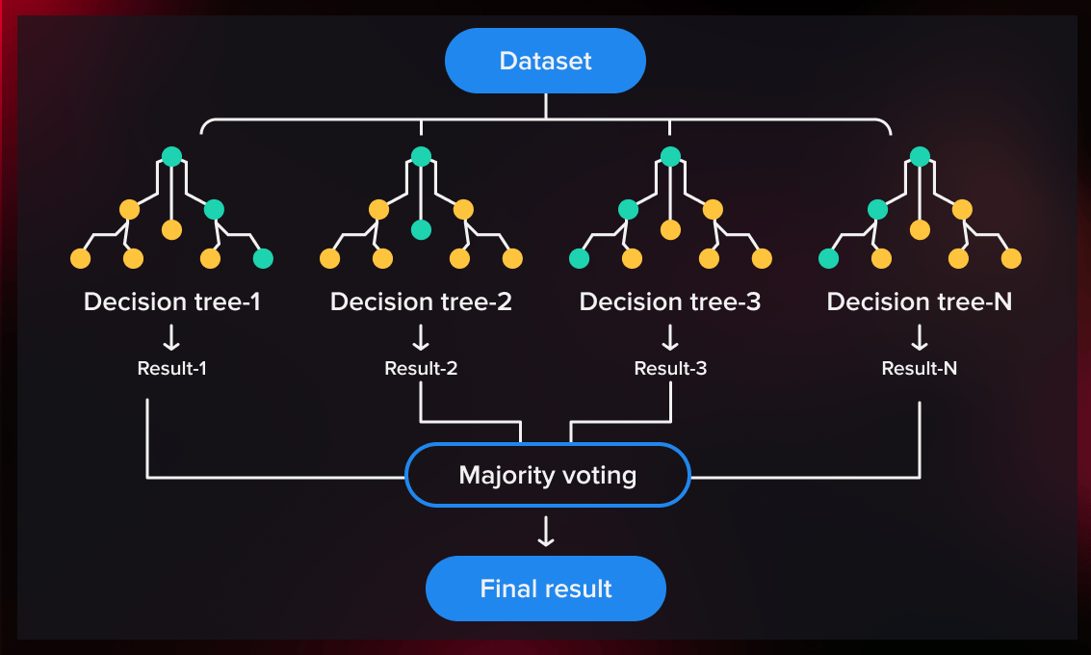
Random Forest
“Random Forest is an ensemble method that builds multiple decision trees on different subsets of the data and combines their predictions. It can handle non-linear relationships, noise, and high-dimensional data better than simpler models”

Slide 18
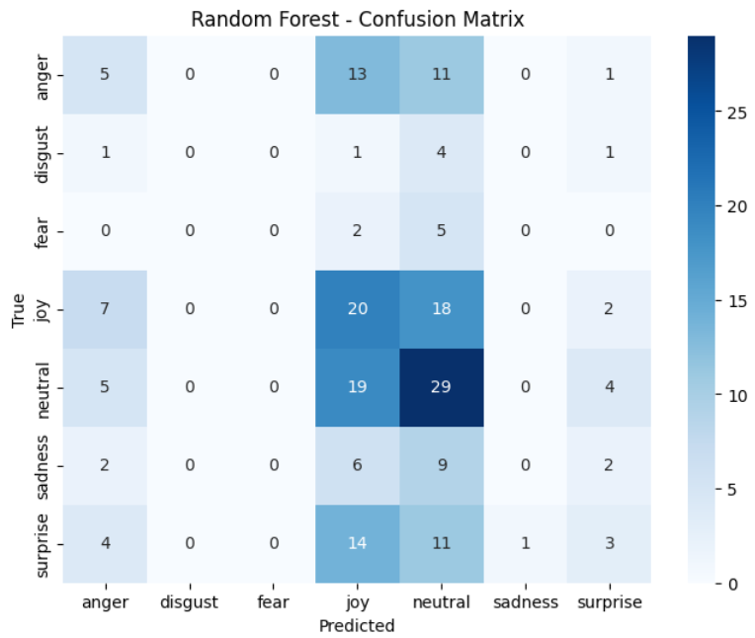
Results and limitations
Our Logistic Regression model showed moderate success in identifying highly expressive emotions like anger and joy.
The model frequently confused neutral with other emotions — particularly joy, sadness, and surprise. This was expected, as neutral often shares acoustic features (like low energy or flat tone) with milder expressions of emotion.
When the tone differs, audio alone isn’t always reliable for detecting subtle emotional intent.

Slide 19
TEXT unimodal
Using TF-IDF

Slide 20
Text only : Using Tf-idf
In this approach, we aimed to classify emotions using only the text transcripts of the utterances.
This approach converts each utterance into a high-dimensional sparse vector, based on how frequently words appear in a given utterance and how rare they are across the entire dataset.
These vectors were then fed into classical classifiers — the same ones used in the audio unimodal approach — to evaluate how well words alone can reveal emotion.

Slide 21
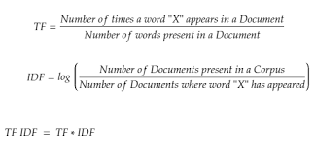
What is tf-idf
It transforms each utterance into a vector that reflects the importance of each word
Words that are common within a sentence but rare across the dataset receive higher weights.
This helps emphasize emotionally charged words like “hate”, “love”, or “afraid”, while downplaying frequent but uninformative words like “the” or “is
it ignores word order and context

Slide 22
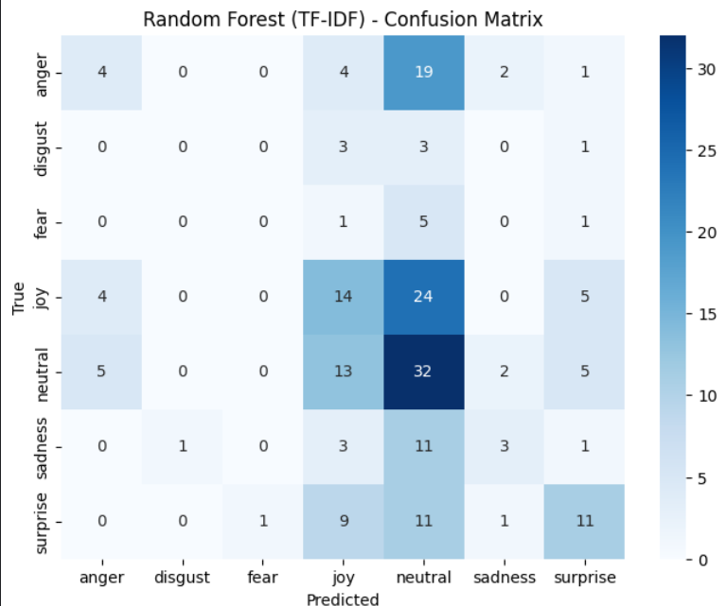
RESULTS and limitations
The model showed improvement in the interpretation of emotion like “surprise” as tonal data in case of audio model could result in mis-classification
It treats words independently and ignores their order. So sentences like “I’m not happy” may be misread as positive.

Slide 23
Text Unimodal
GloVe BASED

Slide 24
Our Approach using Glove
We improved upon TF-IDF by using GloVe word embeddings to represent each utterance. GloVe captures semantic meaning and word relationships using dense vectors
For each utterance, we averaged the GloVe vectors of its constituent words to produce a single 100-dimensional sentence embedding.
Unlike TF-IDF, GloVe can recognize that “joyful” and “happy” are related, giving it a better chance of understanding subtle emotional expressions.

Slide 25
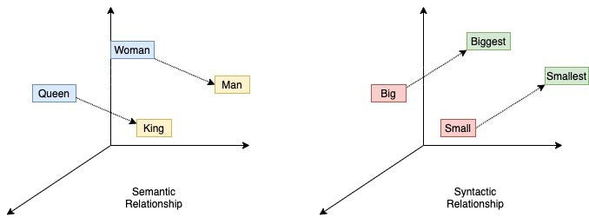
What is glove?
GloVe (Global Vectors for Word Representation) is a pre-trained embedding model that maps each word to a fixed-length vector based on its global co-occurrence statistics across large text corpora
GloVe captures semantic relationships between words — for example, “happy” and “joyful” will have similar vector representations.

Slide 26
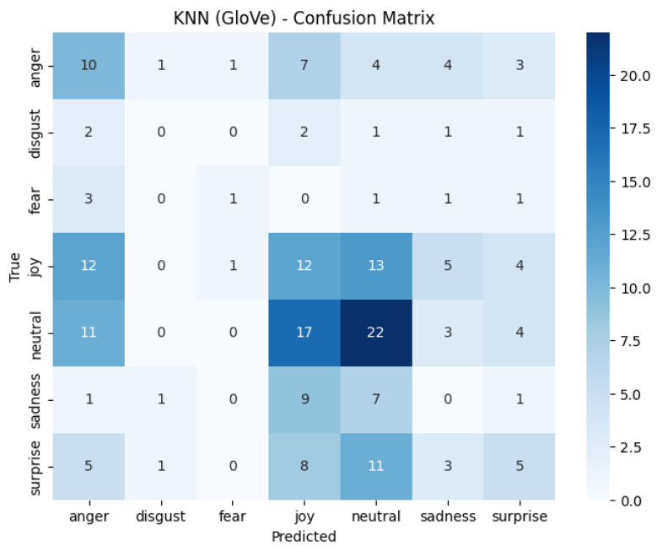
Results and limitations
The GloVe-based model showed notable improvement over TF-IDF in terms of capturing overall meaning.
It performed better in detecting emotions like anger and joy, likely because these emotions have distinct word usage patterns that GloVe captures through semantic similarity.
Even during mis-classification, misclassified into overlapping emotion class
The averaging of word vectors discards word order and sentence structure, which limits the model’s ability to handle negation or sarcasm

Slide 27
Combining the 2 modalities
Early Fusion

Slide 28
Early Fusion – Our Approach
To overcome the limitations of unimodal models, we combined both text and audio features using early fusion.
For each utterance, we extracted a 100-dimensional GloVe embedding to capture the semantic content of the sentence, and a 16-dimensional audio feature vector to capture vocal tone and energy.
These two vectors were then concatenated to form a single 116-dimensional feature vector. This fused representation was used as input to our classical classifiers.
The aim was to combine the advantages of both modalities

Slide 29
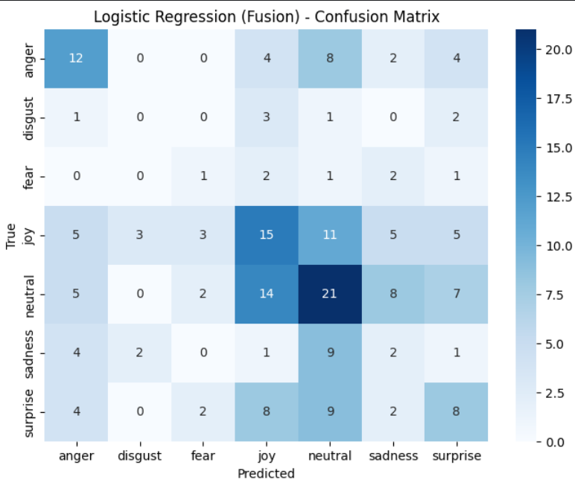
Results and Limitations
The fusion-based Logistic Regression model achieved the most consistent results across emotions
It correctly predicted a significant number of anger, joy, and neutral cases, reflecting the advantage of combining text semantics with vocal features.
Unlike unimodal models, it made fewer extreme misclassifications and showed a better balance across all classes.
However, the model still struggled with closely related emotions like surprise, fear, and sadness, which were often confused with one another. This was likely due to overlap in both vocabulary and tonal features

Slide 30
Conclusion and Challenges

Slide 31
Challenges and future scope
The MELD dataset was heavily imbalanced, with neutral dominating most splits. Handling this without losing representation from minority classes was tricky
Training separate LSTM models for audio and text could model temporal patterns and speech dynamics more effectively.
Experimenting with late fusion or attention-based multimodal architectures could further reduce confusion between similar emotions like joy, surprise, and neutral.

